Slide 1
Grammar
It’s note taking time!!!!

Slide 2
Past Tense
The past tense indicates an action completed at a specific time in the past
Example:
Luis Astorga broke his arm last week.
Broke indicates an action completed at a specific time in the past

Slide 3
Present Tense
Present Tense
Indicates an action that is going on at the present time or that occurs habitually
Examples:
The man looks off into the distance.
Looks reflects an action go on at a present time
The seasons change four times a year.
Change reflects an action that occurs habitually

Slide 4
Future Tense
The future tense indicates an action which will take place in the future
Example
Ms. Jones will repair the television set tomorrow.
Will repair indicates an action to be performed in the future

Slide 5
Perfect Tense
The perfect tense ALWAYS contains a form of the verb have ( have, has, had)

Slide 6
Participles
Two principle parts of the verb, either the past participle or the present participle.
Regular verb past participle ends in ed
Irregular verb past participle ends in en or t
The present participle both regular and irregular end in ing

Slide 7
Present Perfect
Present perfect is formed from the appropriate present tense form of the verb have (has or have) plus the past participle and indicates an action that is completed at the present time or that is continuing into the present.
Has or have + past participle=Present Perfect
Ex- Mike has completed the research for his new book
Has completed indicates an action that is completed at the present time

Slide 8
Past Perfect
The past perfect tense is formed from the past tense form of the verb have (had) plus the past participle and indicates an action completed before a specific time in the past.
Had + past participle=Past Perfect
Ex- The girl had broken the vase before her mom could get there.
Had broken indicates an action completed before the mother’s arrival

Slide 9
The Future Perfect tense
The future perfect tense is formed from the future tense of the verb have (will have or shall have) plus the past participle and indicates an action that will be completed before a specific time in the future.
Will have+past participle=Future Perfect
EX- The teacher will have graded the papers before class tomorrow.
Will have graded indicates an action that will be completed before class time tomorrow

Slide 10
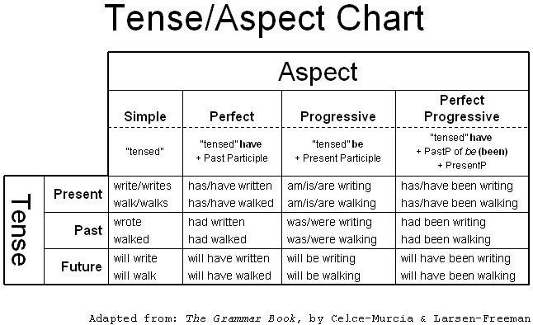

Slide 11
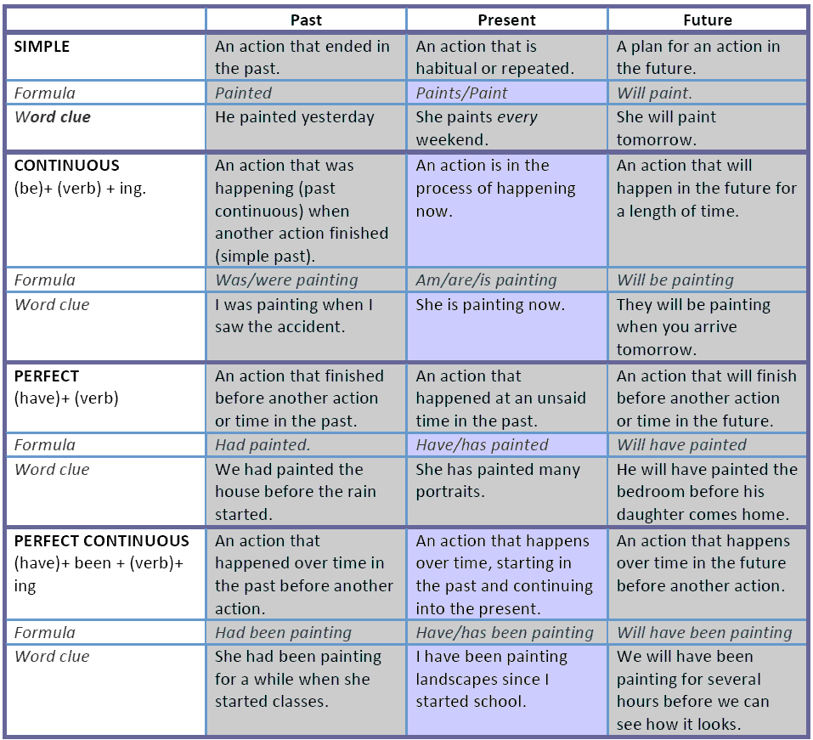

Slide 12
Practice: Indicate the tense of the red words
I enjoy sports myself.
I once played for the Metropolis Muppets.
Each player had been individually recruited.
In fact, no Muppet team has ever won a game.

Slide 13
VOICE
Active Voice
The subject is the doer of action.
Ex- Nelson played the game.
The verb played is in the active voice because the subject Nelson is doing the action
Passive Voice
The subject is the receiver of the action
The passive voice is composed of a form of auxiliary verb be (am, are, is was, were)
Ex-The game was played by Nelson.
The verb was played is in the passive voice because the subject game received the action

Slide 14
Practice-Active or Passive
1. The bat was made by the Louisville Slugger Company.
2. The girl outran the shortstop’s throw.
3. Michael Jordan plays basketball for the Chicago Bulls.
4. My mother works with an accounting firm in Atlanta.
5. The company car was sold by the business manager.

Slide 15
Infinitive
An infinitive begins with the word to and is followed by a verb form
Example-To conserve energy is wise.
To conserve is an infinitive
To wisely conserve energy. (split-infinitive)
This is incorrect when writing formally.
Infinitive is the base form of the verb. The infinitive form of a verb is the form which follows "to". For example:
(to) go, (to) be,(to) ask, (to) fight, (to) understand, (to) walk . Infinitives may occur with or without the infinitive marker "to". Infinitives without "to" are known as "bare infinitives".

Slide 16
Gerunds
Gerunds- are present participles and thus always end in ing
A GERUND ALWAYS FUNCTIONS AS A NOUN (although it looks like a verb)
Running is a good way to stay trim.
Eating people is wrong.
Hunting tigers is dangerous.
Flying makes me nervous

Slide 17
Gerunds
Gerunds (-ing)
When a verb ends in -ing, it may be a gerund or a present participle. It is important to understand that they are not the same.
Gerunds are sometimes called "verbal nouns".
When we use a verb in -ing form more like a noun, it is usually a gerund:
Fishing is fun.
When we use a verb in -ing form more like a verb or an adjective, it is usually a present participle:
Anthony is fishing.
I have a boring teacher.

Slide 18
Gerunds as Subject or Object (subjects usually do the action, objects receive the action)
Try to think of gerunds as verbs in noun form.
Like nouns, gerunds can be the subject or object of a sentence:
I don't like writing.
My favorite hobby is reading.
But, like a verb, a gerund can also have an object itself. In this case, the whole expression [gerund + object] can be the subject or object of the sentence..
I don't like writing letters.
My favorite hobby is reading detective stories.
Like nouns, we can use gerunds with adjectives (including articles and other determiners):
pointless questioning
a settling of debts
the making of Titanic

Slide 19
But when we use a gerund with an article(An article is a kind of adjective which is always used with and gives some information about a noun a/an and the, they are used very often and are important for using English accurately) it does not usually take a direct object:
a settling of debts (not a settling debts)
Making "Titanic" was expensive.
The making of "Titanic" was expensive.
My favorite hobby is reading.
My favorite niece is reading.
Do you see the difference in the these sentences? In one, "reading" is a gerund (noun). In the other "reading" is a present participle (verb).

Slide 20
Gerunds after Prepositions
This is a good rule. It has no exceptions!
A preposition describes a relationship between other words in a sentence.
If we want to use a verb after a preposition, it must be a gerund. It is impossible to use an infinitive after a preposition. So for example, we say:
I will call you after arriving at the office.
I am looking forward to meeting you.
Do you object to working late?
Tara always dreams about going on holiday.
Notice that you could replace all the above gerunds with "real" nouns:
I will call you after my arrival at the office.
I am looking forward to our lunch.
Do you object to this job?
Tara always dreams about holidays.

Slide 21
Gerunds after Certain Verbs
We sometimes use one verb after another verb. Often the second verb is in the infinitive form, for example:
I want to eat.
But sometimes the second verb must be in gerund form, for example:
I dislike eating.
This depends on the first verb. Here is a list of verbs that are usually followed by a verb in gerund form:
admit, appreciate, avoid, carry on, consider, defer, delay, deny, detest, dislike, endure, enjoy, escape, excuse, face, feel like, finish, forgive, give up, can't help, imagine, involve, leave off, mention, mind, miss, postpone, practise, put off, report, resent, risk, can't stand, suggest, understand

Slide 22
Look at these examples:
Do you feel like going out?
I can't help falling in love with you.
I can't stand not seeing you.
Some verbs can be followed by the gerund form or the infinitive form without a big change in meaning: begin, continue, hate, intend, like, love, prefer, propose, start
I like to play tennis.
I like playing tennis.
It started to rain.
It started raining.

Slide 23
Gerunds in Passive Sense
We often use a gerund after the verbs need, require and want. In this case, the gerund has a passive sense.
I have three shirts that need washing. (need to be washed)
This letter requires signing. (needs to be signed)
The house wants repainting. (needs to be repainted)
Here is a brief review of the differences between gerunds and infinitives.
Gerunds are formed with ING:
walking, talking, thinking, listening
Infinitives are formed with TO:
to walk, to talk, to think, to listen

Slide 24
Review
Gerunds and infinitives can do several jobs:
Both gerunds and infinitives can be the subject of a sentence::
Writing in English is difficult. To write in English is difficult.
Both gerunds and infinitives can be the object of a verb::
I like writing in English. I like to write in English.

Slide 25
But...
Only gerunds can be the object of a preposition:
We are talking about writing in English.
It is often difficult to know when to use a gerund and when to use an infinitive. These guidelines may help you:

Slide 26
Gerunds are often used when actions are real, concrete or completed:
I stopped writing. (The writing was real and happened until I stopped.)

Slide 27
Infinitives are often used when actions are unreal, abstract, or future:
I stopped to write. (I was doing something else, and I stopped; the writing had not happened yet.)

Slide 28
The three types of verbals are: gerunds, participles, and infinitives.
Gerunds and participles are also compared and contrasted because they can both end in -ing but have different functions in a sentence.

Slide 29
A gerund is a verbal that ends in -ing and functions as a noun. The term verbal indicates that a gerund, like the other two kinds of verbals, is based on a verb and therefore expresses action or a state of being. However, since a gerund functions as a noun, it occupies some positions in a sentence that a noun ordinarily would, for example: subject, direct object, subject complement, and object of preposition.

Slide 30
Gerund as subject:
Traveling might satisfy your desire for new experiences.
The study abroad program might satisfy your desire for new experiences.
Gerund as direct object:
They do not appreciate my singing.
They do not appreciate my assistance.

Slide 31
Gerund as object of preposition:
The police arrested him for speeding.
The police arrested him for criminal activity.

Slide 32
Form & Use of Verbs
Mood or Mode
The attribute(quality) of a verb suggesting the speaker’s attitude toward the action expressed.
There are 5 verb moods in English: Indicative, Imperative, Subjunctive, Interrogative, and Conditional.

Slide 33
Form & Use of Verbs
Indicative Mood
Used for a statement of fact or when a question presents the answer.
Statement of Fact: Ex. He is a unique individual.
Question presents the answer: Ex. He is a unique individual, isn’t he?

Slide 34
Form & Use of Verbs
Imperative Mood
Expresses a command or request.
It is usually used in the Present tense with the Second person (you).
Often, the subject of the command/request is the “understood” you.
Sometimes, it is used with the Third person.
Ex. Open the door. (The subject is the understood you.)
Ex. Fix me something to eat. (The subject is the understood you.)
Ex. You come here now!
Ex. Someone give me a hand. (Third person subject)

Slide 35
Form & Use of Verbs
Interrogative Mood
Used to ask a question.
It is important to note that the form of the verb does not change but rather the auxiliary verb is placed at the beginning of the question.
Ex. Will you be there?
Ex. Shall I prepare dinner?

Slide 36
Form & Use of Verbs
Conditional Mood
Describes a condition that would have to exist in order to make the Independent Clause come true.
This may refer to an uncertain event that is conditional upon other things occurring.
These statements may vary widely, ranging from that which is certain to that which is totally contrary to fact or unlikely.
Ex. If you drink poison, you will get sick.
Ex. When I tease my dog, he usually bites me.
Ex. If you were to be backstage at the concert, you may get to meet the star.
Ex. If I had a lot of money, I would invest in gold.

Slide 37
Form & Use of Verbs
Subjunctive Mood
Derives from another time and was used more in classical English literature than it is today.
Generally, the Subjunctive expresses an idea that is doubtful or uncertain.
Some regard Subjunctive mood as the mode of futurity; it expresses an idea that may or may not come to pass.
There are some common expressions that are known as Formulaic Subjunctives.
Ex. God bless you.
Ex. Be that as it may.
Ex. If it please the court.
Ex. Come what may.
Ex. Perish the thought.
Ex. God save the Queen.

Slide 38
Subjunctive mood
Indicative expresses fact
Imperative expresses command
Subjunctive expresses conditions contrary to fact or expresses urgency/demand:
If I were you, I would drive home on Sunday.
I insist that he drive home on Sunday.

Slide 39
Use of Comma
To indicate a pause or a break.
Between items in a series.
Ex. The experience demanded blood, sweat, and tears.
Between coordinating conjunctions joining Independent Clauses.
Ex. Congress passed the bill by a wide margin, and the President signed it into law.

Slide 40
Use of Comma
To indicate a pause or a break.
Around parenthetical elements.
Ex. The invention, the first in a series during that decade, completely changed people’s lives.
After introductory phrases, especially those of four words or more, preceding the main clauses of sentences.
Ex. After carefully studying all documents, scholars could not reach a conclusion.

Slide 41
Use of Comma
To indicate a pause or a break.
In dates.
Ex. He was born June 23, 1988, in Charlotte, North Carolina.
In addresses.
Ex. Rosemary Brady of 160 Carroll Street, Brooklyn, New York, visited her sister in Brooklyn, Maryland.

Slide 42
Use of Ellipsis
To indicate a pause or a break.
Ellipsis points are spaced periods that are used in a sentence to indicate that there is a word, phrase, sentence, or paragraph missing from a quoted passage.
Ex. In seeking causes for plagues in the Middle Ages, Barbara W. Tuchman writes, “Medical thinking . . . stressed that air is the communicator of disease, ignoring sanitation or visible carriers.”

Slide 43
Use of Dash
To indicate a pause or a break.
Around parenthetical elements that represent a break in the flow of thought.
Ex. The low unemployment figures—New York City, for example, had its lowest rate in twenty years—masked the growing social unrest.

Slide 44
Use of Dash
To indicate a pause or a break.
Around parenthetical elements that require a number of internal commas.
Ex. Many twentieth-century American writers—Faulkner, Capote, Styron, Welty, to name only a few—come from the South.

Slide 45
Use of Dash
To indicate a pause or a break.
Before a summarizing Appositive.
Ex. Computer chips, integrated circuits, bits, and bytes—these new terms baffled yet intrigued.

Slide 46
Correct these sentences
Mom fusses a lot about me trashing my room.
When I was a kid, I swang every day on an old tire my dad hanged in a tree for me.
I wish I’d waken up earlier.
Bill breaks the dish when he tossed it to Laura who is standing at the sink.
If I was you, I’d buy that gorgeous dress.
I’ve laid awake all night worrying about my math test.
I worked for three hours, and finally the assignment was completed.
I’m sure I lay my assignment on the teacher’s desk yesterday. Where could it possibly have gone?
If you want to really, truly, without a doubt thrill your teacher, don’t split infinitives.
The headline read “ Local Kid Won Scholarship from Pizza Hut.”

Slide 47
Directions: Read the sentences, identify the infinitive in each sentence below.
“To conquer Mount Everest is my goal!” exclaimed Erika.
In the past, Burton was terrified to play the tuba on Tuesdays.
“To succeed takes courage, foresight, and luck,” announced Nick to an awestruck Cameron.
Stranded in the freezing snowstorm, all Kira wanted was to survive.
Afraid to move, Evan froze in terror as the huge cobra slithered over his left foot.

