Slide 2
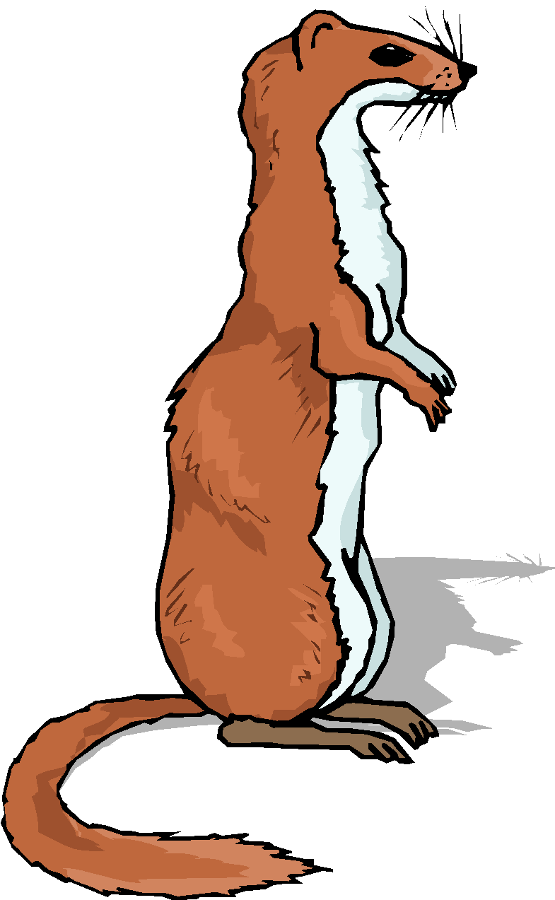
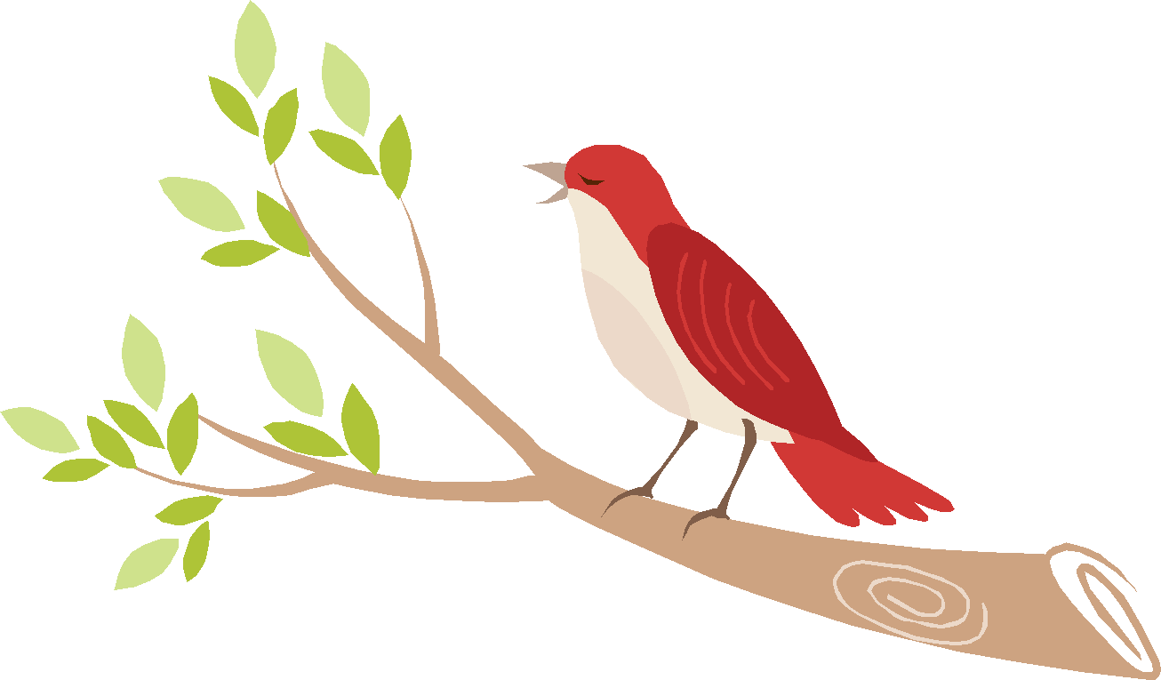
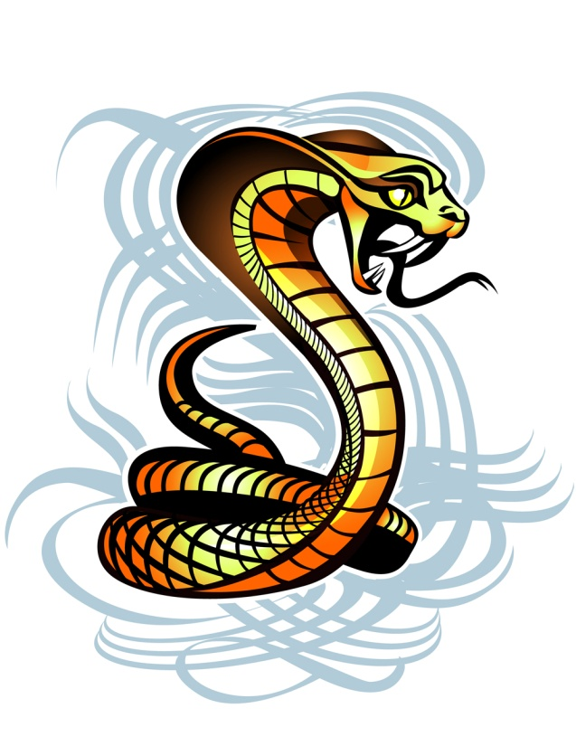
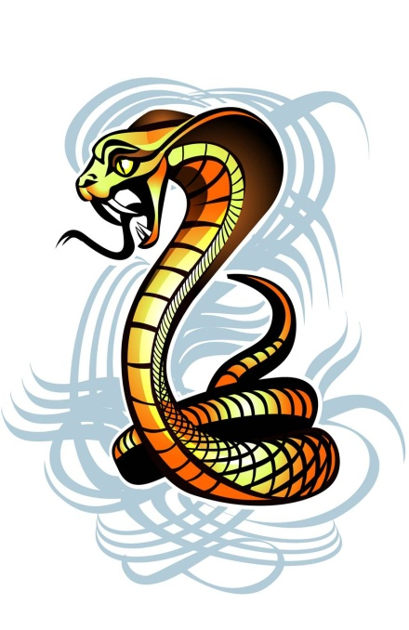
“Rikki-Tikki-Tavi” by, Rudyard Kipling
Story Preview

Slide 3
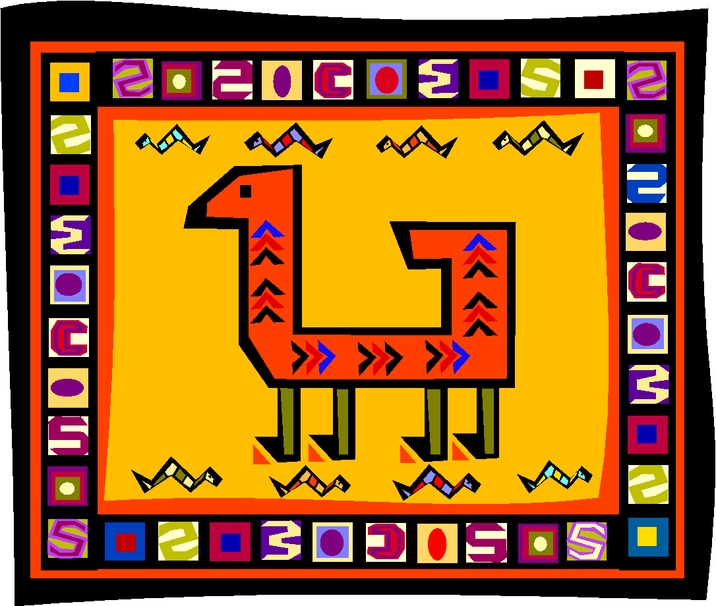
RUDYARD KIPLING- AUTHOR 1865-1936
Born in Bombay, India.
Had English parents, and moved back to England when he was six.
He was very attached to his native land, and returned there as a journalist.
His stories about India were published in England and were immediately successful.
The Jungle Book, Kim, and Captains Courageous became successful films.
Kipling was the first English author to win the Nobel Prize for Literature.

Slide 4
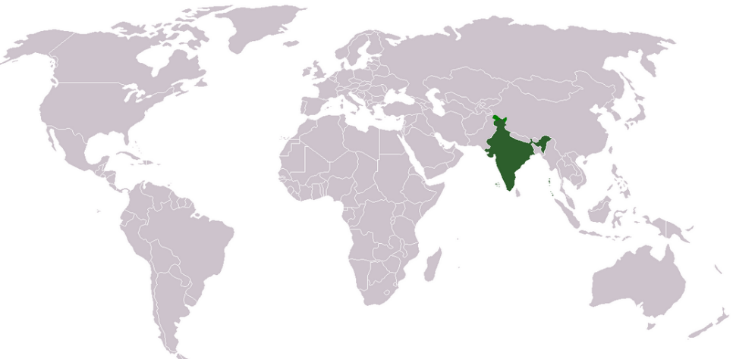
Setting
The story is set in the late 1800’s. Back in those days, Great Britain ruled India. “Rikki- Tikki-Tavi” takes place in a bungalow’s (cottage) garden in Colonial India.

Slide 5
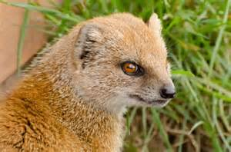
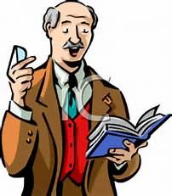
Point of View
Point of view is the viewpoint from which the story is told.
Rikki Tikki Tavi is told in third person. A narrator is telling the reader what is happening in the story.

Slide 6
Vocabulary You Should Know
Burrow - den
Stealth – secret action
Bungalow - cottage
Horrid – awful, horrible
Cower - cringe
Fledgling – baby bird
Veranda – patio, porch
Cultivate - plow
Sluice - drain
Quiver - shake
Flutter – flap wings
Revived - awakened
Draggled – wet and dirty
Cunningly - cleverly
Mourning – sorrow for a death
Consolation – source of comfort

Slide 7
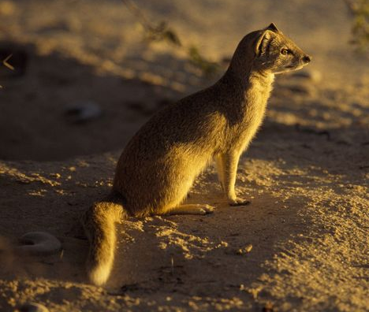
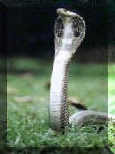
Cobra vs. Mongoose
Who do you predict will win? Why?

Slide 8
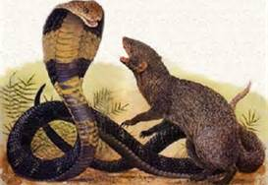
Mongoose Vs. Cobra Video
http://video.nationalgeographic.com/video/animals/reptiles-animals/snakes/cobra-vs-mongoose-predation/

Slide 9
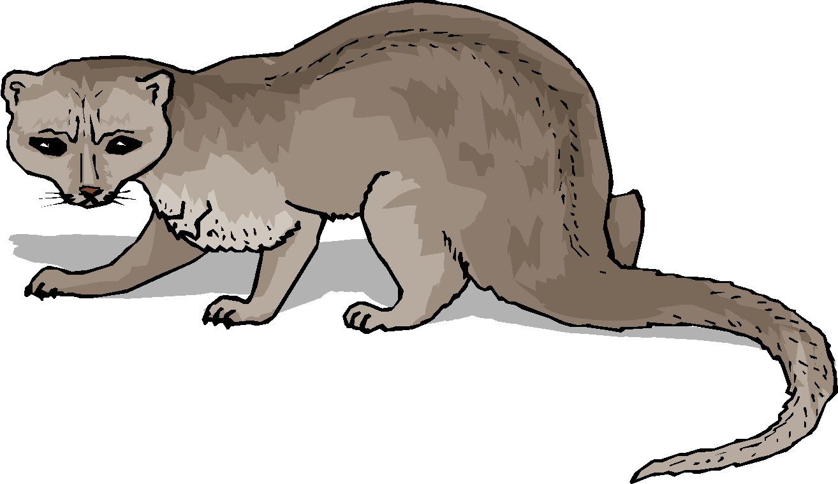
Anticipation Guide – True or False?
Mongooses are hunted by cobras as prey
Mongooses hunt cobras as prey
Cobras are highly venomous
Mongooses live in Africa and Asia
Cobras live in Africa and Asia
Mongooses are herbivores
A group of cobras is called a quiver
A group of mongooses is called a troop

Slide 10
Anticipation Guide – True or False?
Mongooses are hunted by cobras as prey FALSE
Mongooses hunt cobras as prey TRUE
Cobras are highly venomous TRUE
Mongooses live in Africa and Asia TRUE
Cobras live in Africa and Asia TRUE
Mongooses are herbivores FALSE
A group of cobras is called a quiver TRUE
A group of mongooses is called a troop TRUE

Slide 11
Characters
Rikki Tikki Tavi: The main character (protagonist). Rikki is a small but brave mongoose who defends his home and friends against their enemies.
Nag: Rikki’s enemy (antagonist). Nag is one of the cobras Rikki must fight to keep the garden safe.
Nagaina: Rikki’s enemy (antagonist). Nagaina is another cobra that Rikki must fight to keep the garden safe.
Teddy: The young boy in the story. Rikki fights to protect him.
Darzee: One of Rikki’s friends. Darzee is a tailorbird. He helps Rikki during the story.
Chuchundra: Another one of Rikki’s friends. He is a very timid muskrat that helps Rikki.
Karait: A small deadly snake that Rikki encounters in the garden close to Teddy.
Teddy’s parents: Teddy’s mother is a little afraid of Rikki, but Teddy’s father thinks he is good to have around.

Slide 12
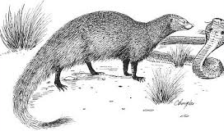
Theme
One theme from Rikki Tikki Tavi would be courage to protect your family from harm. Rikki, the mongoose, has to fight two cobras, Nag and Nagaina, to protect his garden and Teddy. He is frightened of them because they are stronger and bigger than he is, but he overcomes his fear and fights them anyway.

Slide 13
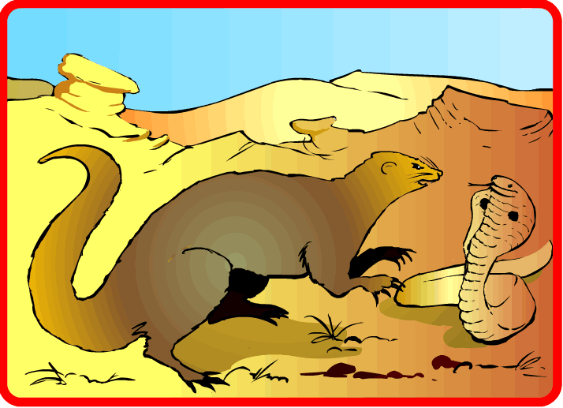
Plot Diagram
Climax
Falling Action
Rising Action
Exposition
Resolution

Slide 14
Literary Elements
Plot- the sequence of events
Setting- the time and place of the story
Conflict- a struggle between two forces
Character – major and minor
Theme – the lesson behind the story
Tone – the author’s attitude
Mood – the reader’s feeling

Slide 15
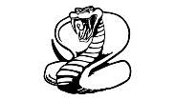
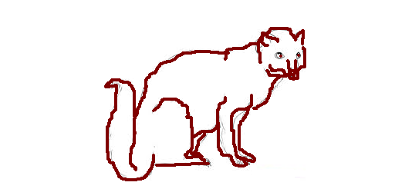
Strategies for Reading Short Stories
Preview
Predict – what do YOU think will happen?
Connect with a character – usually the protagonist
Make inferences – get clues from your reading
Ask questions
Reread

Slide 16
Thank you for downloading. I hope that you enjoy the resource and get a lot of use out of it. Please let me know if you have any questions or concerns. My email address is happyedug8r@msn.com or you can message me via social media.
Commercial Graphics used with permission from the following: Microsoft Design, GraphicStock.com, pixabay.com and the following artist:
For more teaching ideas and freebies, please click on the link to visit my blog! http://www.happyedugator.blogspot.com Also, I would love to have you follow me on Facebook, Instagram, Pinterest, Google +, Twitter, and Linked-In!
Please leave feedback at My TPT Store. http://www.teacherspayteachers.com/Store/HappyEdugator Remember, you will earn credits for leaving me feedback which goes toward any future TPT purchases.
Thank you and happy teaching!
Deborah Hayes
Aka HappyEdugator
Teacher Karma
http://www.TeacherKarma.com
Digital Mojo
https://www.teacherspayteachers.com/Store/Digital-Mojo
Rebecca B Designs
https://www.teacherspayteachers.com/Store/Rebeccab-Designs
This product is the intellectual property of Deborah Hayes aka HappyEdugator. Your purchase buys one license. This resource is for classroom or homeschool use and is intended for the purchaser. Duplication for other classes, for other teachers or for use in wide distribution is not allowed. You may purchase extra licenses at a discount. This material is protected under the Digital Millennium Copyright Act.
©2017 HappyEdugator

